Slide 1
LSB IMAGE STEGANOGRAPHY
Done by
S.YASHVANTH

Slide 2
Objectives
To decode hidden data embedded inside an image using LSB (Least Significant Bit) steganography.
To extract and verify a predefined magic string that confirms the presence of encoded secret data.
To retrieve the secret file’s metadata, including its extension and size, from the encoded image.
To reconstruct the original secret file by decoding its contents bit-by-bit from the image.
To save the extracted data into an output file, restoring the original hidden message.

Slide 3
Foundational Requirements
C Programming Fundamentals → Variables, pointers, dynamic memory allocation, bitwise operations.
String Functions → strcmp, strcpy, strlen for validating magic string, file extensions, and decoded data.
File Handling (Binary Mode) → fopen, fread, fwrite, fseek for reading encoded image data and writing output files.
Modular Programming → Separate functions for decoding magic string, extension, size, and secret data to maintain clean design.
Bit Manipulation Logic → Extracting LSB bits from each byte of the image to reconstruct characters and file contents.

Slide 4
features
Magic String Verification → Confirms the presence of hidden data by validating a predefined magic signature.
File Extension Extraction → Decodes and reconstructs the original secret file extension from image LSBs.
Secret File Size Retrieval → Extracts the encoded size information to allocate accurate memory for secret data.
LSB Bit Decoding → Reads the least significant bits of image bytes to rebuild characters and binary content.
Dynamic Memory Utilization → Adjusts buffer sizes using malloc/realloc for flexible decoding of variable-length data.
Output File Reconstruction → Writes the decoded secret content into a newly generated file matching the original format.
Error Handling & Validation → Detects invalid magic strings, incorrect file sizes, missing data, and corrupted encodings.

Slide 5
PROGRAM Flow
Command-line Interface: ./a.out -d <stego_image.bmp> <output_file>
File Validation: Checks if the input image exists and is in BMP format.
Confirms successful opening of the encoded image file.
Header Processing: Skips the 54-byte BMP header reserved for metadata. Ensures the image is large enough to contain encoded data.
Magic String Verification: Reads the LSBs of initial bytes to reconstruct the magic string. Validates the magic signature to confirm hidden data presence.
Data Decoding: Sets error_flag for invalid tokens or formatting.
Stops token generation if errors are found.
Output File Generation: Creates a new file using the decoded extension. Writes the reconstructed secret data into the output file.

Slide 6


Slide 7
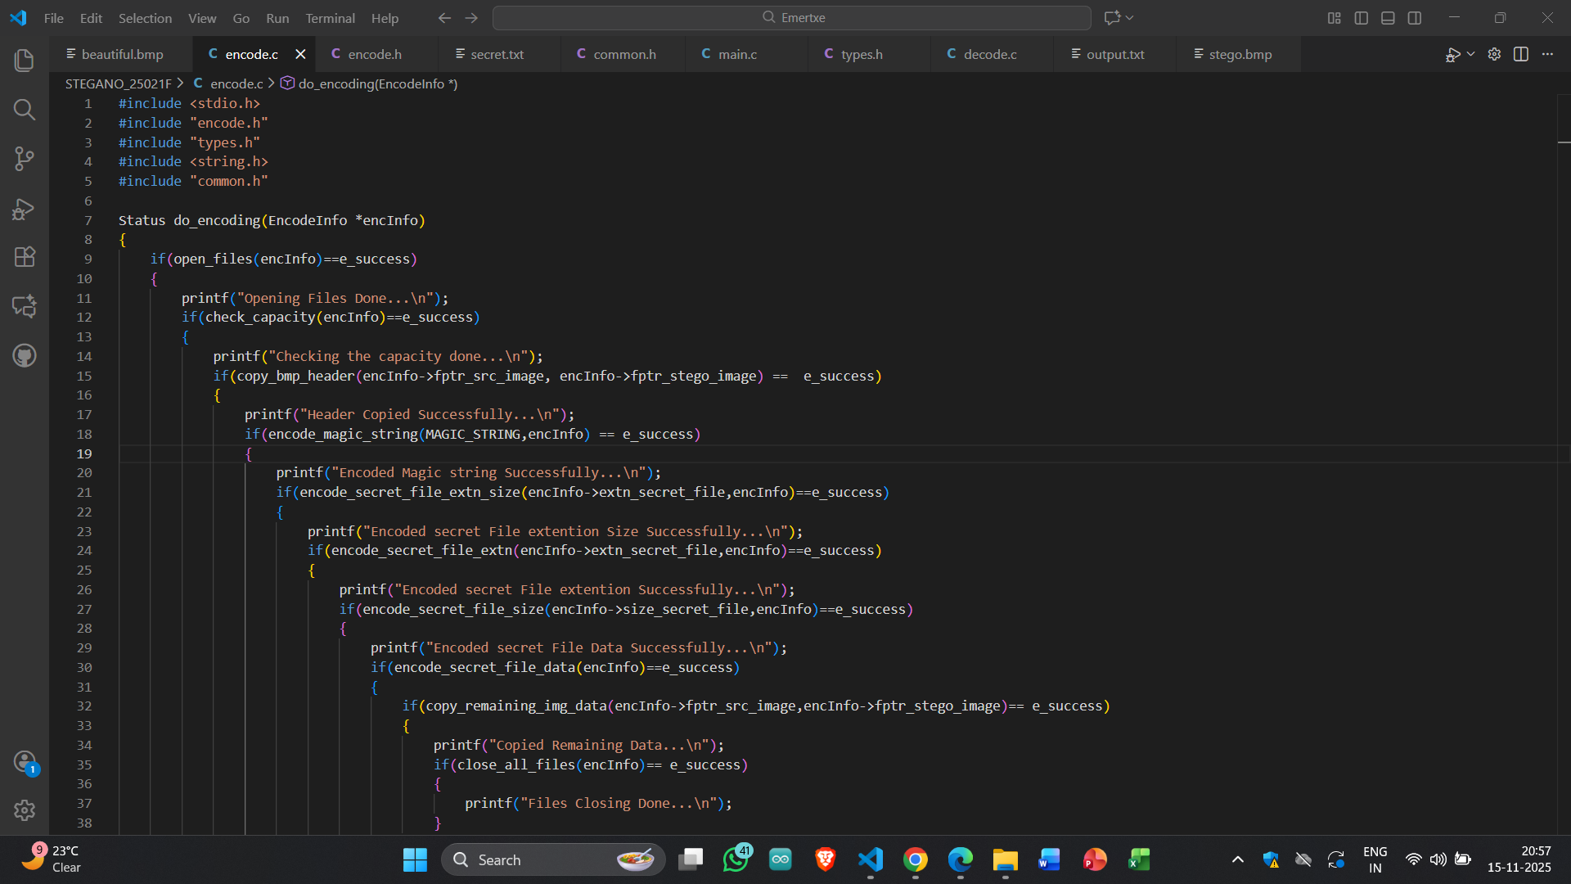

Slide 8
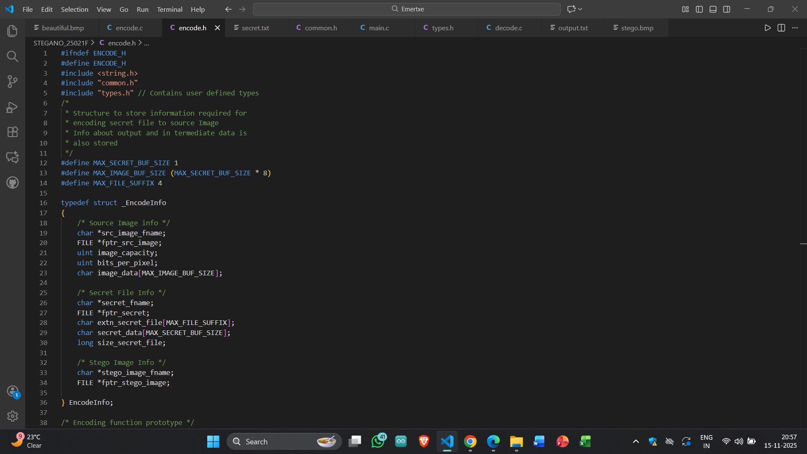

Slide 9
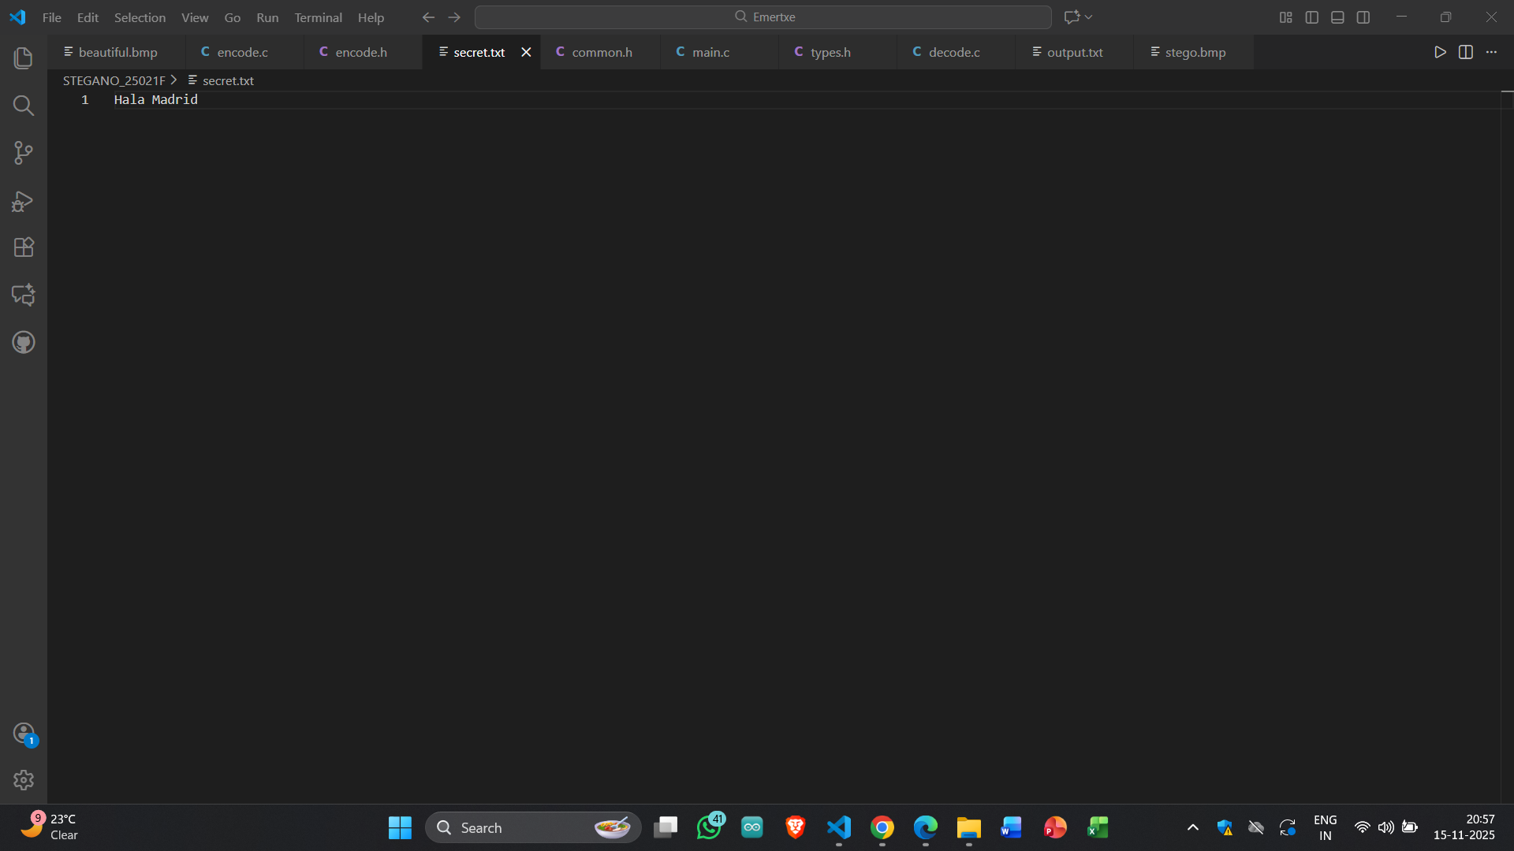

Slide 10
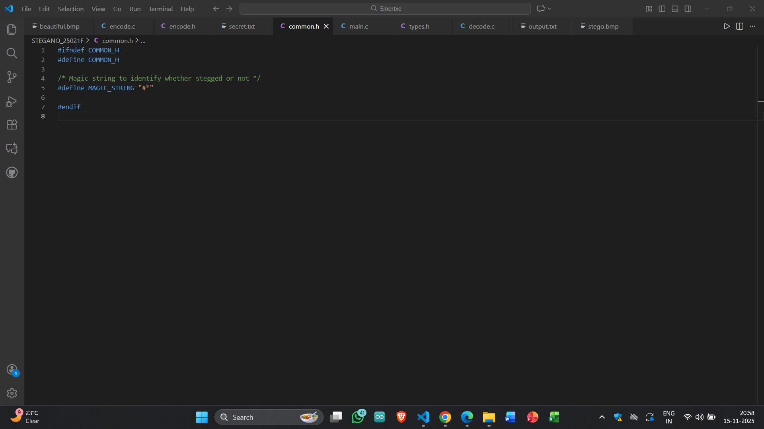

Slide 11
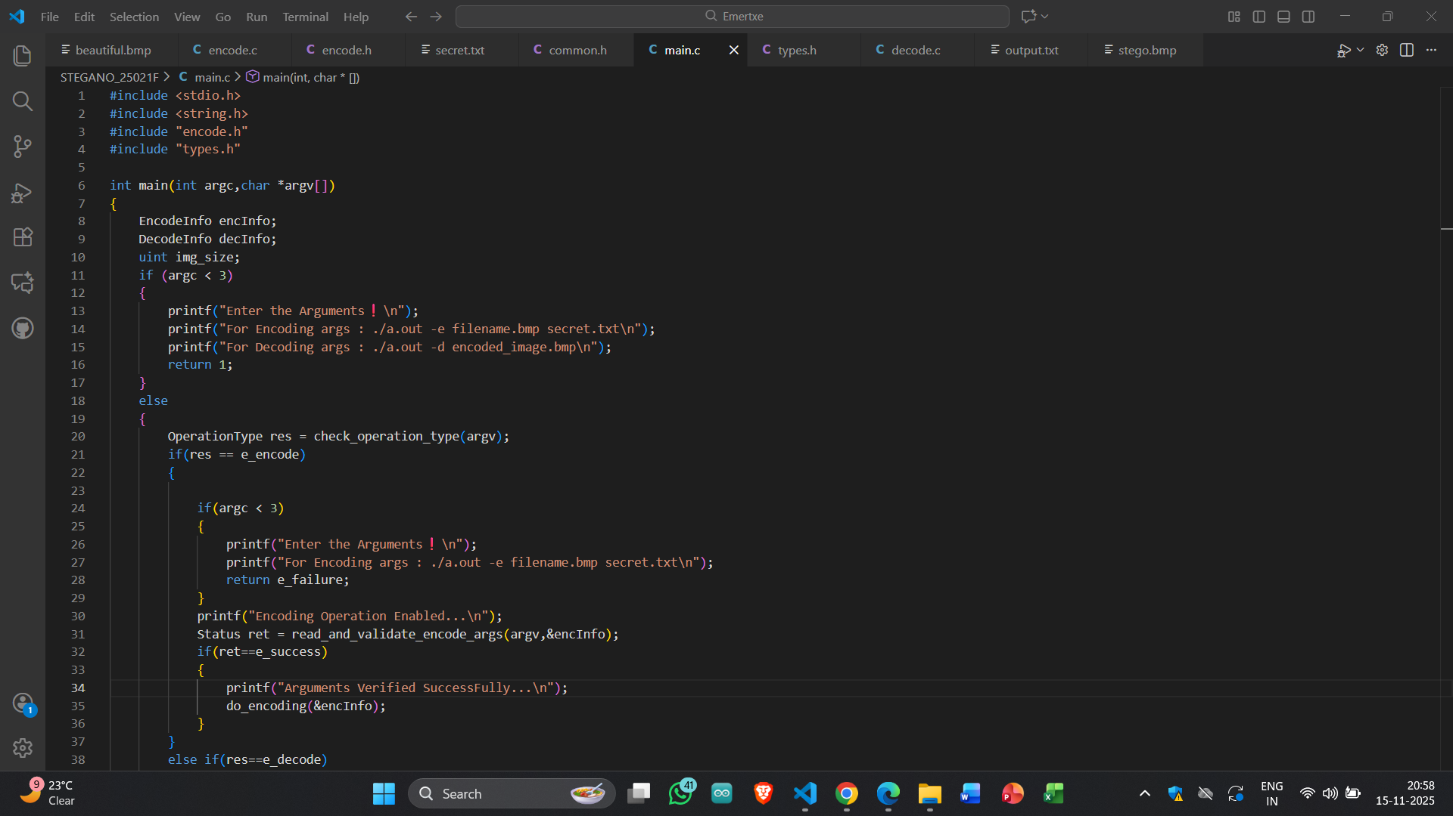

Slide 12
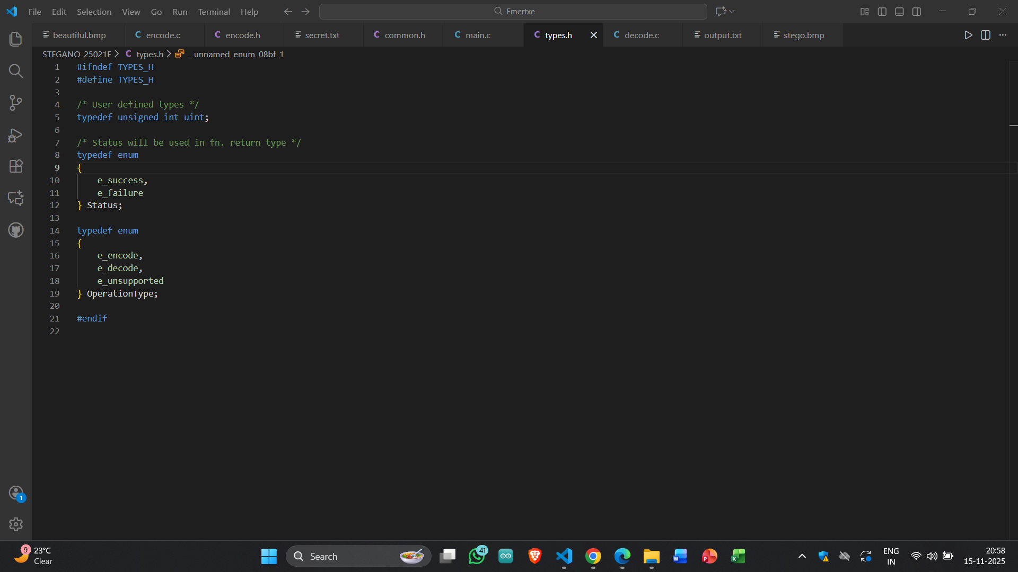

Slide 13
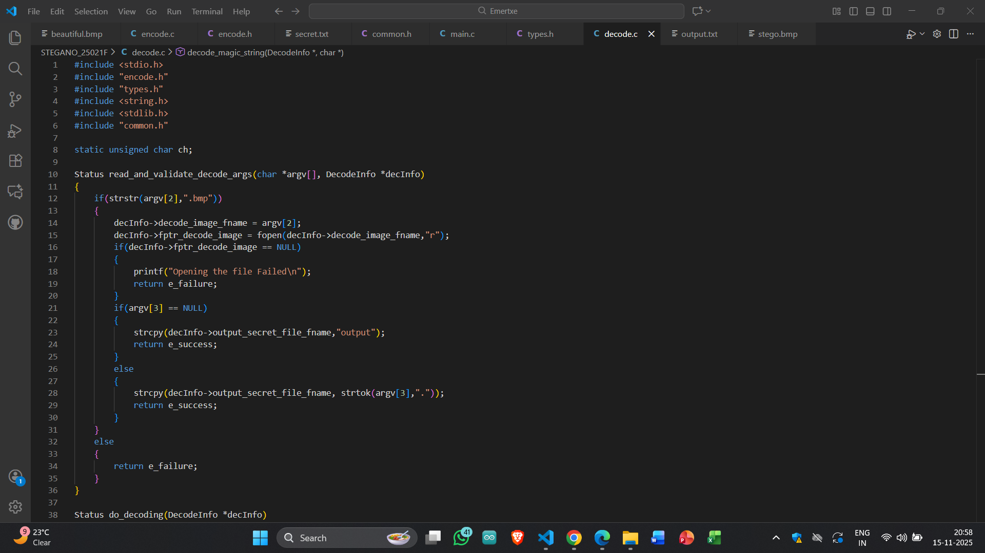

Slide 14


Slide 15
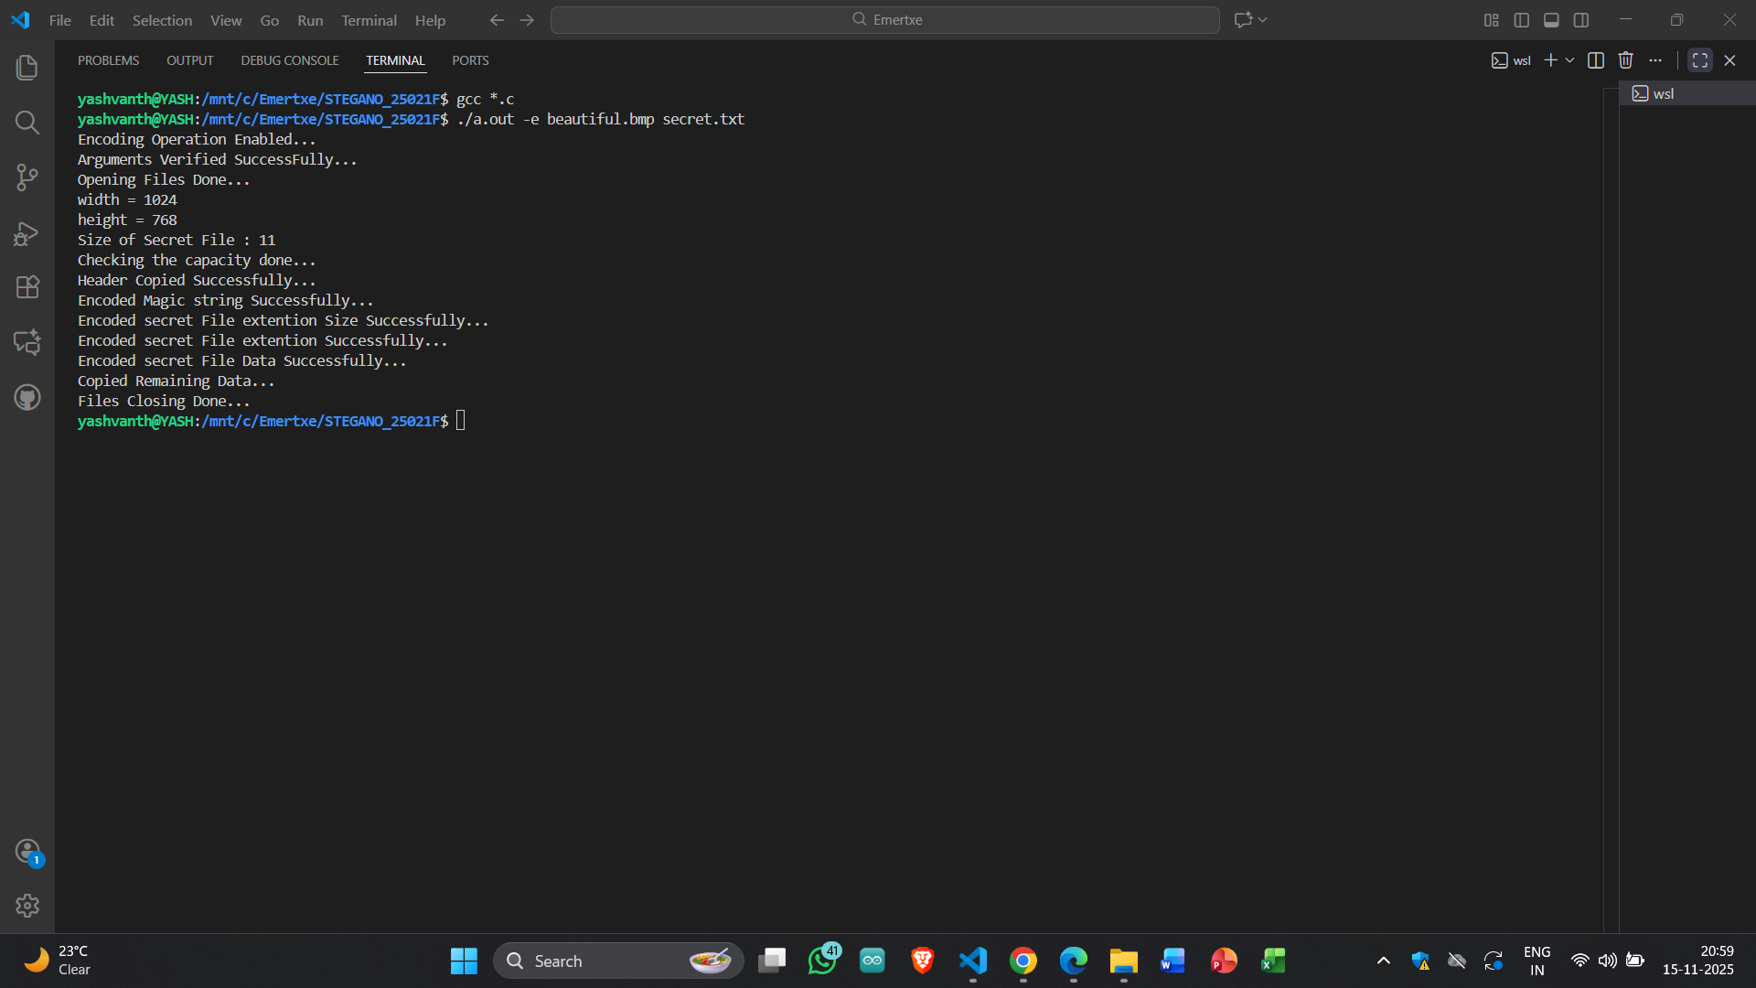

Slide 16
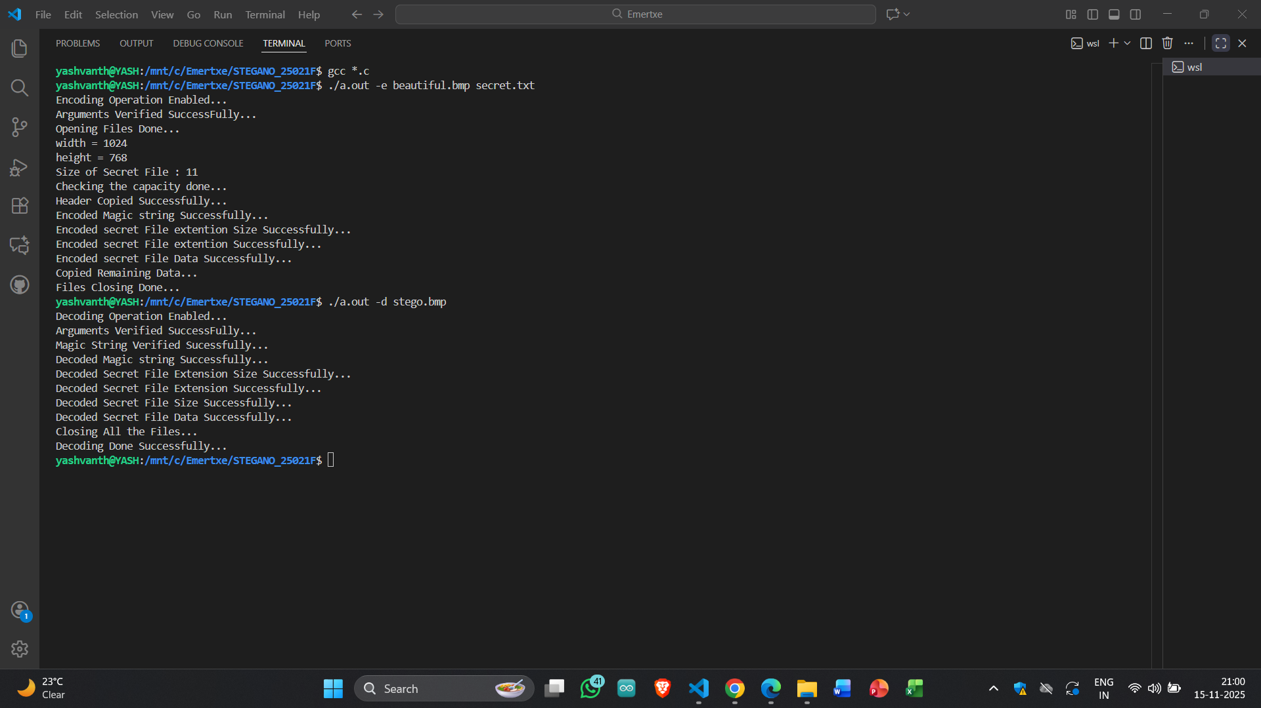

Slide 17


Slide 18
Core Takeaways
Deep Understanding of Steganography Design: Gained hands-on experience with Least Significant Bit (LSB)–based data hiding and retrieval from BMP image files.
Strong Mastery of C Programming Fundamentals: Enhanced skills in pointers, arrays, file operations, memory allocation, and bitwise manipulation.
Practical Implementation of Decoding Logic: Designed and developed functions to extract magic strings, file extensions, file sizes, and secret data from encoded images.
Advanced Bit-Level Data Processing Skills: Learned to reconstruct characters by combining LSB-extracted bits, ensuring accurate conversion from binary patterns to readable data.

